Slide 1
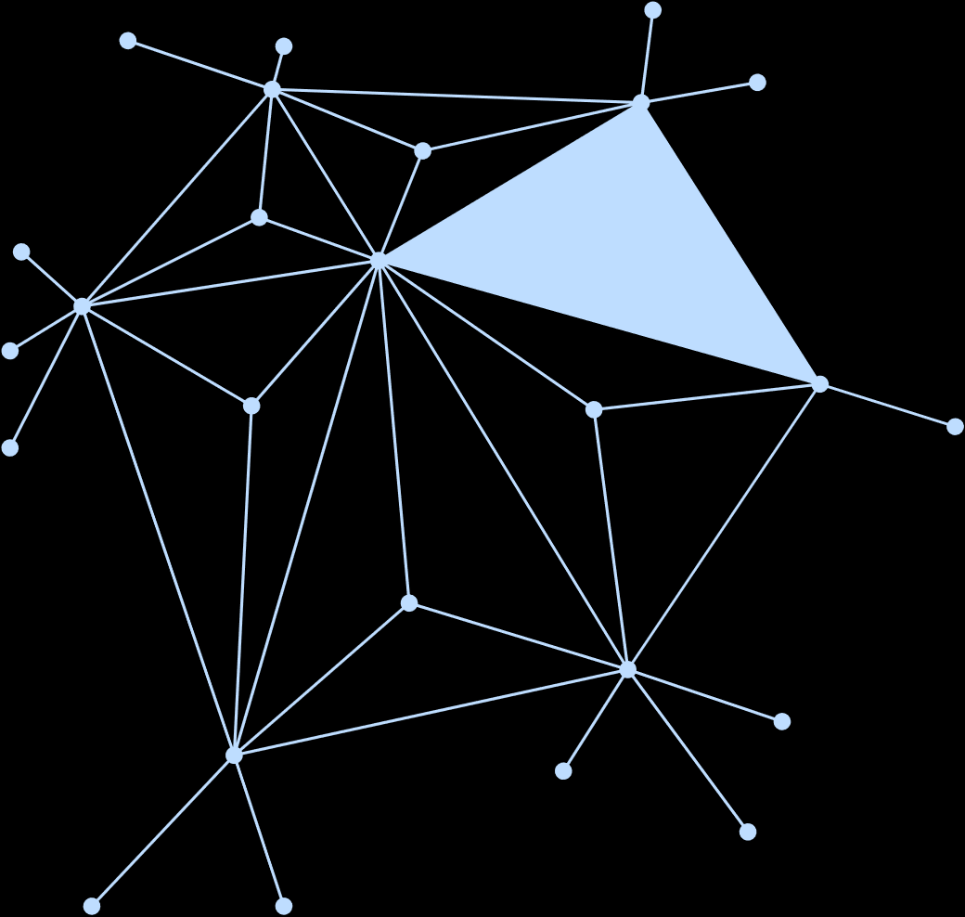
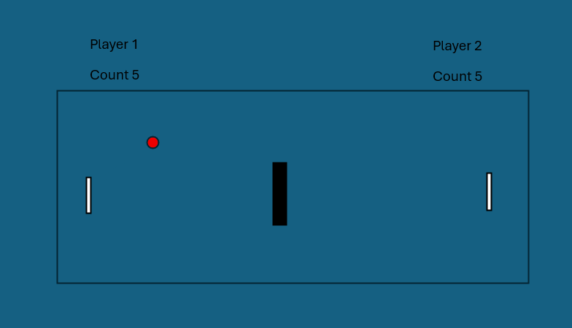
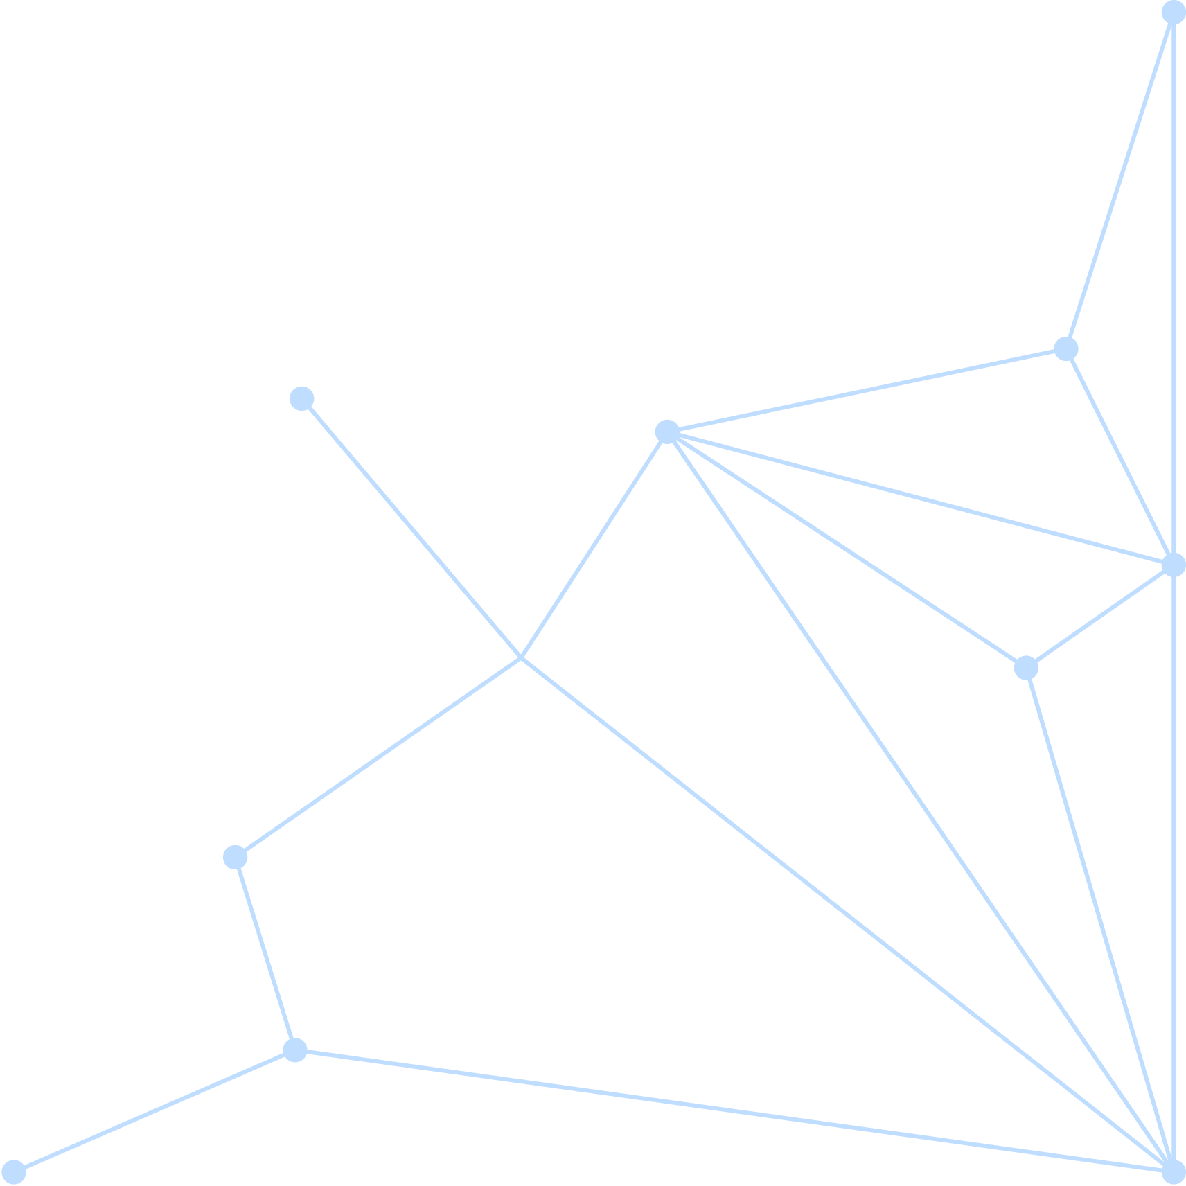
Mini Table Tennis Game
Team Pixel Warriors
What
Does it Do ?
ball
This is a two-player mini table tennis game where players use keys to control paddles and hit the ball.
The goal is to keep the ball in play and score points by successfully hitting it.
The game becomes faster over time, and it ends when one player misses the ball.
Programming
Concepts it demonstrates
paddles
Variables: Positioning and speed (float/int).
Conditionals: if statements for collision and boundary checks.
Functions: Modular code structure (moveball(), paddleball(), etc.).
Coordinate System: Using X and Y axis for movement in a 2D space.
Group Members
M. L. Wiksura - 2024/ICTS/021
A. P. U. Jayasiri - 2024/ICTS/024
A. A. L. N. Bandara - 2024/ICTS/101
K. P. C. S. Jayakodi - 2024/ICTS/036
www.reallygreatsite.com
@reallygreatsite
hello@reallygreatsite.com

Slide 2
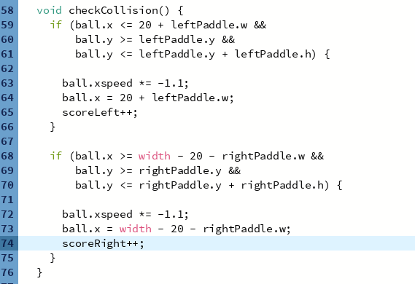
The Code
Brief
Explanation.
This logic checks if the ball’s X-position has reached the paddle and if its Y – position is written the top and bottom edges of the paddle to trigger a bounce.
Key Section of Code (Example)
Interesting design decisions.
Randomization: Using random(2, 4) for ball speed so the game starts differently every time.
Input Handling: Using both character keys (“W”,”S”) and keycode (UP, DOWN) to allow
two players on one keyboard.
Challenges
Encountered and solved.
Challenge: The ball getting “stuck” inside the paddle.
Solution: Manually resetting the ball’s X position (x = 20 + paddlew) immediately after a hit to ensure it stays outside the paddle area.

Slide 3
References & Reflection
All Sources.
One Sentence from Each member
Processing.org(Reference Documentation).
The Coding Train (YouTube Tutorials).
AI Tools (Debugging and logic optimization).
“Building this game helped me see how math and physics are used in coding.”
“Solving the collision logic was the most rewarding part of the project.”
What each
Team member learned:
Understanding how real-time loops (draw()) work in programming.
Handling user input efficiently to create a smooth gaming experience.
What you would
Improve with more time:
Sound Effects: Adding “beep” sounds for paddle hits and “game over” sounds.
AI Opponent: Creating an automated paddle for single-player mode.
Visuals: Adding a “Start Menu” and different difficulty levels.

